Slide 1

Space elevators
DUVIVIER Valentin - M1 CMI - April 2nd 2021
1

Slide 2
Plan
Objectives
Working principle
Cable
Tension
Equations
Visual
Buckling eigenmodes
Equations
Visual
Conclusion
Bibliography
2

Slide 3
Objectives
Reach space to develop space conquest.
Spatial platform.
Satellite launching.
3

Slide 4

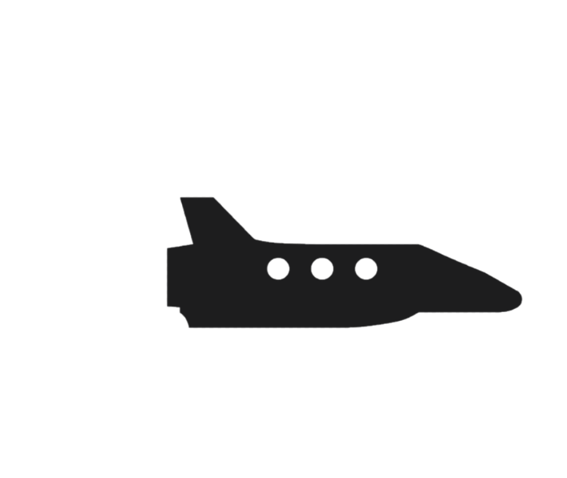

Working principle
z
M
GEO - Geostationary Orbite
Equilibrium gravity
Spacecraft launching
GEO
4

Slide 5

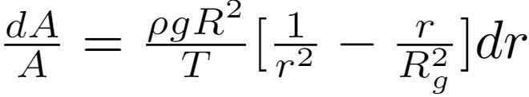

Cable - Tension
z
M
R_{g} : GEO’s altitude
R : Earth’s radius
A : Cross section area
4

Slide 6
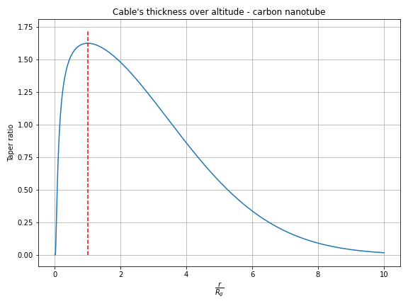
Cable
Material
A_{EGO} = 5 x A_{s}
Kevlar
Steel
Carbon nanotube
5

Slide 7
Buckling eigenmodes
Causes
Consequences
Payload : speed of probe / satellite / spacecraft at launching
Natural : big winds, Coriolis force
Direct damage
Oscillations : flexion / longitudinal eigen-modes
Oscillations/
Vibrations
Launching
Impulsion
7

Slide 8
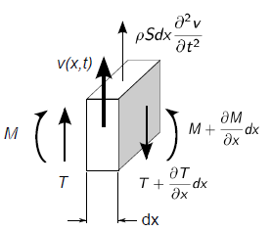
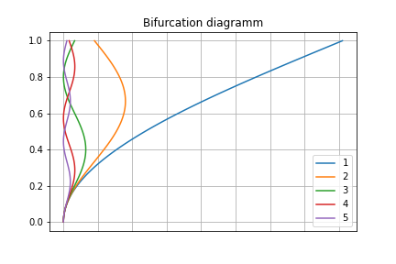

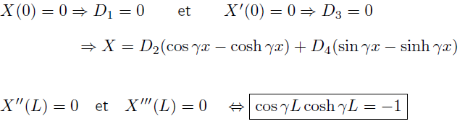

Buckling eigenmodes
7

Slide 9
Conclusion
Major technological project
Cross scientific fields
Launchable by 2030 - Nihon University
9

Slide 10
Bibliography
O. Earl. GIF image. http://www.earlotsuka.com/?portfolio=animations. [consulted on 24/03/2021]
P.K. Aravind, (2007. “The physics of the space elevator”. American Journal of Physics.’ [consulted on 24/03/2021]
Y. Matsunaka, March 13th 2019, https://redshift.autodesk.com/japan-space-elevator/ [consulted on 26/03/2021]
Course “Waves and vibrations” Master Spi - Sorbonne Université [consulted on 28/03/2021]
10

